Slide 1
Introduction of algae
Prepared by:Prof. Dr. Ahmed M. Athbi
University of Basrah
College of Education for Pure Science
Department of Biology

Slide 2
Structure of cell walls:
In general algal cell walls are made up of three
forms are:
1- Mucopolymeric from: contain from amino
acids or glucoamino acids (cyanophyta)
2- Cellulosic form: contain from cellulose,
Hemicellulose or polysaccharide
( chlorophyta, Euglenophyta)
3- Silicified form: contain from silica or silica add it
pectin (Bacillariophyceae)

Slide 3
Storage Products
The storage products that occur in the algae are as follows:
1- High-moleculer-weight compounds
α- 1,4- glucans such as:
- True starch Chlorophyta
- Mexophycean starch Cyanophyta
- Foleridean strach Rhodophyta

Slide 4
β- 1,3 – glucans such as:
- Paramylon Euglenophyta
- laminarine Phaeophyceae
- Chrysolaminarine Chrysophyceae
Bacillariophyceae

Slide 5
2- Low-moleculer weight compounds such as:
- Manitole pheophyceae
- Mannoglycerate Rhodophyta
- Cyanophycine Cyanophyta

Slide 6
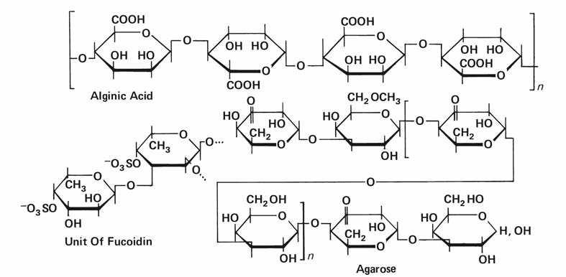
Structural units of alginic acid, fucodin, and
agarose. (After Percival and McDowell, 1967.)

Slide 7
Flagella
Algal cells can have different arrangements of flagella:
- Isokont: flagella are of equal length.
- Anisokont: flagella are of unequal length.
- Heterokon: flagella are with a hairy and a smooth
flagellum.
- Stephanokont : flagella are from a ring at one
end of the cell.

Slide 8
Achronematic: The flagellar membrane may not have hairs on its surface
Pantonematic: The flagellar membrane may have hairs on its surface
Flagella classified into three kinds from position into:
- Anterior
- Posterior
- Lateral

Slide 9
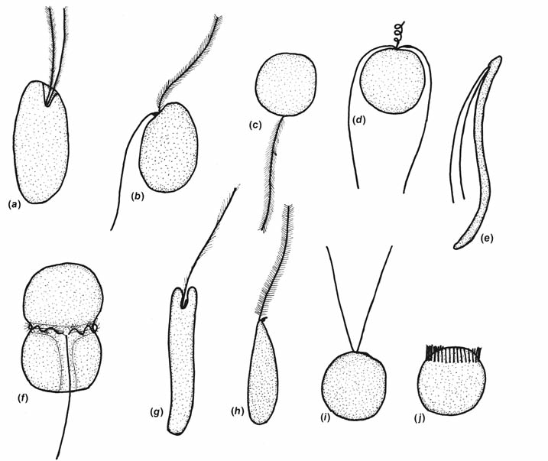
The shape of eukaryotic motile lgal cells and their flagella. The drawings represent the common arrangement of flagella in the groups. There are a number of modifications in structure that are not included here. (a) Cryptophyta; (b) most of the Heterokontophyta;
(c) Bacillariophyceae of the Heterokontophyta; (d) Prymnesiophyta; (e) Chlorophyta;
(f) Dinophyta; (g) Euglenophyta; (h) Eustigmatophyceae of the Heterokontophyta;
(i, j) Chlorophyta. a

